Slide 1
FDR & THE NEW DEAL
1933

Slide 2
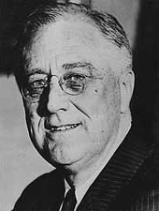
Franklin D. Roosevelt
Franklin Delano Roosevelt
Defeated Herbert Hoover
32nd President of the U.S.
President from 1932 to 1945.
Democrat.
Diagnosed with Polio.
Created the New Deal.
Third greatest U.S. President.
“Nothing to fear but fear itself.”

Slide 3
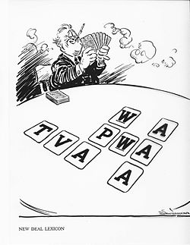
The New Deal
FDR’s reaction to the Great Depression.
Created many new government agencies between 1933 and 1938.
Made the government much bigger.
Key components were the three R’s.
Relief of the unemployed.
Recovery of the economy.
Reform of the financial system.

Slide 4
The Three R’s
Relief - Immediate action taken to halt the economy’s deterioration.
Recovery - "Pump - Priming" Temporary programs to restart the flow of consumer demand.
Reform - Permanent programs to avoid another depression and insure citizens against economic disasters.

Slide 5
Programs
1933 Civilian Conservation Corps (CCC)
Provided jobs.
1933 Federal Emergency Relief Administration (FERA)
Unemployment compensation.
1933 Public Works Administration (PWA)
Created jobs for government projects.
1933 Emergency Banking Relief Act (EBRA)
Closed banks for a “holiday.” Struggling banks stayed closed until they could get the funding they needed.

Slide 6
Programs (cont.)
1933 Glass-Steagall Act (GSA)
Created the Federal Deposit Insurance Company (FDIC)
Protected the money in savings accounts for citizens.
1933 National Industrial Recovery Act (NIRA)
Sent money to states to aid with making more jobs.
1933 National Recovery Administration (NRA)
Enforced fair competition in the market.
1933 Federal Securities Act (FSA)
Corporations required to provide information of all stock information.
Held them liable.

Slide 7
Programs (cont.)
1933 Agricultural Adjustment Administration (AAA)
Paid formers to produce less crops.
Raised crop profits for farmers.
Was replaced by the Soil Conservation and Domestic Allotment Act
1933 Tennessee Valley Authority (TVA)
Aided the Tennessee Valley area with developing resources.
Dams were the primary source.
Home Owners Loan Corporation (HOLC)
Low interest mortgage loans.

Slide 8
Programs (cont.)
1934 Federal Housing Administration (FHA) & United States Housing Authority (USHA)
Loans for cheap housing and building repair.
1934 Securities and Exchange Commission (SEC)
Monitored the stock market.
1935 National Youth Administration (NYA)
Job training for young adults and students.
1935 Works Progress Administration (WPA)
More jobs created.

Slide 9
Programs (cont.)
1935 Banking Act
Seven-Member board to regulate the money supply and interest rates on loans.
1935 Rural Electrification Administration (REA)
Affordable electricity in rural areas.
1935 Wagner Act
Replaced the 1933 NIRA.
Protected unions and union workers.
1935 Social Security Administration (SSA)
Insurance for retiree’s 65+.
Unemployment compensation.
Aid for families with disabled children.

Slide 10
Programs (cont.)
1938 Food, Drug, and Cosmetic Act (FDC)
Required ingredient labels.
1938 Fair Labor Standards Act
Minimum wage.
Maximum hours in a work week.
Children under 16 cannot legally be hired.
Children under 18 cannot work in hazardous environments.

Slide 11
Opposition
FDR increased taxes on the wealthy to help fund the new deal.
Upper class felt “betrayed”.
The Supreme Court found many of his programs unconstitutional.
11 of 16 programs were found unconstitutional.
Senator Huey Long of Louisiana wanted more done for the poor.
Take from the rich, give to the poor.
Free Education.
Died in 1936.

Slide 12
Opposition (cont.)
Governor Alf Landon ran against FDR in 1936.
The Great Depression was still not completely resolved.
Landon used this to gain leverage in the polls.
1936 Election.
FDR defeats Landon by a landslide.
Landon only won two states.
Most crushing election since 1820.

Slide 13
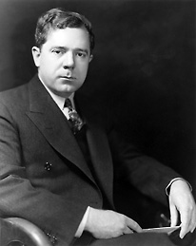
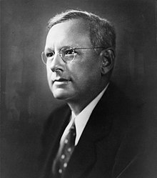
Opposition (cont.)

Slide 14
Programs Today
Seven programs still active today:
Federal Deposit Insurance Corporation (FDIC)
Federal Crop Insurance Corporation (FCIC)
Federal Housing Administration (FHA)
Farm Credit Administration (FCA)
Tennessee Valley Authority (TVA)
Social Security Administration (SSA)
Securities and Exchange Commission (SEC)

Slide 15
FDR Inaugural Speech
https://www.youtube.com/watch?v=nHFTtz3uucY

Slide 16
QUIZ

